Slide 1
Hereditary Predisposition to Hematologic Malignancy
Sarah A. Bannon, MS, CGC
Texas Society of Genetic Counselor’s Annual Education Conference February 16, 2019

Slide 2
2005
Slide courtesy of Kayla Hamilton, MS, CGC, St. Jude Children’s Hospital

Slide 3
Three years later… (2008)
Slide courtesy of Kayla Hamilton, MS, CGC, St. Jude Children’s Hospital

Slide 4
The following year… (2009)
Slide courtesy of Kayla Hamilton, MS, CGC, St. Jude Children’s Hospital

Slide 5
Eight years later…(2017)
Slide courtesy of Kayla Hamilton, MS, CGC, St. Jude Children’s Hospital

Slide 6
Leukemia doesn’t run in families.

Slide 7
Germline mutations causing leukemia are exceedingly rare.

Slide 8
First published report of familial leukemia
Pediatric leukemia recognized as part of Li-Fraumeni syndrome
RUNX1 (AML1) described as predisposition gene for AML
First successful bone marrow transplant for leukemia
BRCA1 and BRCA2 genes are cloned
1900
1944
1956
1970
1994
2001
2015
2019
>15 genes causing hereditary hematologic malignancies are described

Slide 9
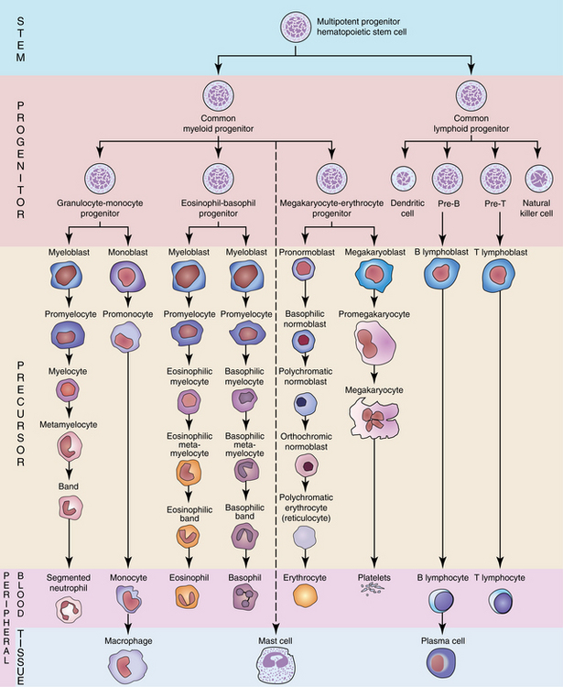
Normal Hematopoiesis
Bone Marrow
Blood
Image: www.clinicalgate.com/hematopoiesis
Notes:
Hematopoiesis is a vigorous process of blood cell production and maturation
Occurs primarily in the bone marrow
Hematopoietic stem/progenitor cells (HSPCs) continuously regenerate blood cells
HSPCs divide rarely (~once/month) but sustain survival for decades
Production of specific blood cell types is driven by tightly controlled system in response to circulating cells in the peripheral blood
HSPCs accumulate rare, random mutations over time
Usually have no effect on the HSPC function
Some mutations confer advantages in self-renewal or proliferation→ clonal expansion

Slide 10
Lymphoid malignancies
Myeloid malignancies
Acute lymphoblastic leukemia (ALL)
Chronic lymphocytic leukemia (CLL)
Hodgkin’s lymphoma (HL)
non-Hodgkin’s lymphoma (NHL)
Multiple myeloma
Acute myeloid leukemia (AML)
Chronic myelogenous leukemia (CML)
Myelodysplastic syndromes (MDS)
Myeloproliferative neoplasms (MPN)
Polycythemia vera
Essential thrombocythemia
Myelofibrosis
Image source: www.patientresource.com/leukemias.aspx
Notes:
Leukemia is a malignancy of the white blood cells. Hematologic malignancies can also include the development of hematopoietic cells elsewhere in the body besides the bone marrow, typically lymphocytes in lymph nodes are other lymphocyte-rich tissues, which are lymphomas (still a heme malignancy because arises from the blood system).
A healthy bone marrow and blood system operates in a very controlled cycle of cell division and maturation, allowing downstream cell products (blasts) to remain in the bone marrow long enough to mature into their final cell type– WBC, platelets, and RBC– which then get released into the blood stream, making room for new blasts to mature.
Leukemia is a space allocation issue. Blood stem cells, often once they’ve differentiated into either myeloblasts or lymphoblasts, acquire mutations that cause them to replicate in an uncontrolled manner– the very definition of cancer. When cells early in the maturation pathway become cancerous, they lead to an excess of blasts in the bone marrow that are all cancerous– resulting in immature cells—blasts– taking the space of healthy maturing cells. Therefore, immature cells get forced prematurely into the blood stream, both causing circulating blasts (which can be detected on a CBC) and decreases in the number of healthy circulating platelets, RBC, WBC, also seen on a CBC. A diagnosis of leukemia can essentially be made by a simple blood count– very high WBC count (malignant WBC!) and low RBC and platelet counts– this is acute leukemia.
LPN: lymphoproliferative neoplasms (Hodgkin’s and non-Hodgkin’s lymphoma, Waldenstrom’s macroglobulinemia, multiple myeloma, CLL)
MPN: Myeloproliferative neoplasms (polycythemia vera, essential thrombocythemia, Myelofibrosis)

Slide 11
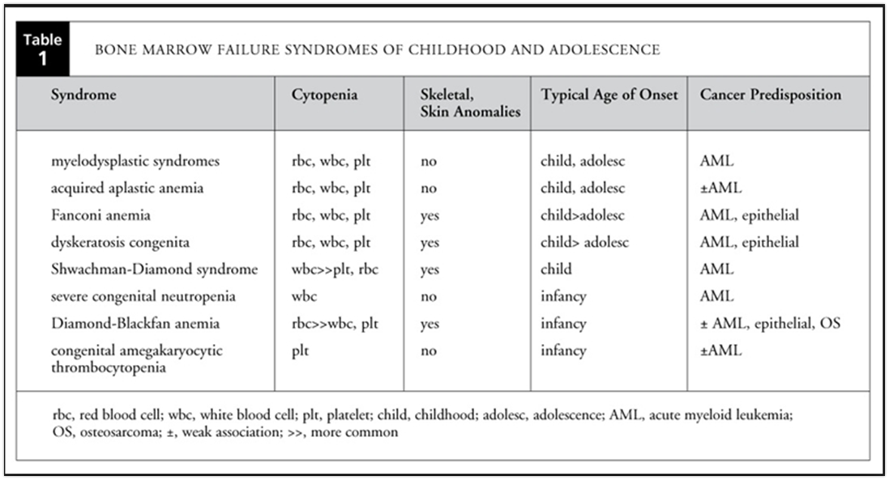
Bone Marrow Failure = aplastic anemia
Hypocellular bone marrow → inability to make enough red blood cells (red cells, white cells, platelets)
Rare: 2-4 cases/1,000,000 ~10% are hereditary 10-15% are acquired due to known risk factors (XRT, viruses) 75% are idiopathic (sporadic)
All individuals with aplastic anemia should be evaluated for inherited syndromes!
H
E
RE DITARY
Table: www.luriechildrens.org
Notes:
Note the age of onset with bone marrow failure syndromes: typically childhood or adolescent
However, increasing these patients are presenting to adult clinics with MDS, AML which we will discuss later

Slide 12
Syndrome | Gene | Inheritance | Heme malignancy | Other characteristics
Familial platelet disorder with propensity to myeloid malignancies | RUNX1 | AD | MDS/AML/T-cell ALL | Thrombocytopenia, bleeding propensity, aspirin-like platelet dysfunction
Thrombocytopenia 2 | ANKRD26 | AD | MDS/AML | Thrombocytopenia, bleeding propensity
Thrombocytopenia 5 | ETV6 | AD | MDS/AML, CMML, B-cell ALL, multiple myeloma, aplastic anemia | Thrombocytopenia
SAMD9-related disorder | SAMD9, SAMD9L | AD | Monosomy 7 MDS/AML | MIRAGE syndrome, ataxia
Familial AML with mutated CEBPA | CEBPA | AD | AML | None
Familial AML with mutated DDX41 | DDX41 | AD | MDS/AML, CMML | None; late onset at diagnosis
GATA2 deficiency | GATA2 | AD | MDS/AML, CMML | None or neutropenia, monocytopenia (MonoMac syndrome)
Familial AML with mutated MBD4 | MBD4 | AR | DNMT3A-mutated AML | None
Myeloid neoplasms with duplications of ATG2B and GSKIP | ATG2B, GSKIP | AD | AML, ET, CMML, myelofibrosis, CML, aCML | None
Telomere Biology Disorders (dyskeratosis congenita) | TERC, TERT Telomere length <1% by flow-FISH | AD AR | MDS/AML, aplastic anemia | Macrocytosis, hypocellular bone marrow, squamous cell carcinomas
Familial aplastic anemia with SRP72 mutation | SRP72 | AD | MDS, aplastic anemia | None
Fanconi anemia | complementation groups FANCA> FANC> FANCG> BRCA2> BRIP1 DEB or MMC assay – abnormal | AR | MDS/AML, aplastic anemia | Short stature, café au lait macules, skeletal malformations, microcephaly Squamous cell carcinomas
Familial B-cell ALL | PAX5 | AD | ALL | None
Germline SH2B3 mutation | SH2B3 | AR | ALL | None
Li-Fraumeni syndrome | TP53 | AD | Familial ALL (hypodiploid) | Young-onset solid tumors (breast, sarcoma)
Familial CLL | POT1 | AD | CLL | Solid tumors (brain, melanoma)
Adapted from Bannon & DiNardo, Int J Mol Sci. 2016.
Notes:
MIRAGE: myelodysplasia, infection, restriction of growth, adrenal hypoplasia, genital anomalies, enteropathy +/- ataxia

Slide 13
How do we identify families with hereditary predispositions to hematologic malignancy?
Why does it matter?
How do we test individuals for germline mutations in the setting of a hematologic malignancy?

Slide 14
Incidence of germline predispositions in MDS/AML
The exact prevalence of inherited germline mutations predisposing to hematologic malignancy is not yet well-described
Current reports suggest between 11-37% of cases of familial hematologic malignancy who are suspected to have an underlying predisposition
2016 revision to the World Health Organization’s classification of myeloid neoplasms included the addition of germline predispositions,
New classification catapulted germline predisposition syndromes into routine practice of hematology-oncologists & hematopathologists
Awareness and consideration of these syndromes among genetic counselors and hereditary cancer experts is considerably lacking
Holme et al. Br J Haematol 2012; DiNardo et al. Clin Lymphoma Myeloma Leuk 2016; Churpek et al. Blood 2015. Arber et al. Blood 2016.

Slide 15
DiNardo CD. Cancer 2018.

Slide 16
Red flags for patients with FHX of heme malignancy
≥2 FDR/SDRs diagnosed with hematologic malignancy
Attempt to determine acute versus chronic, MDS
For lymphoma, attempt to determine Hodgkin’s versus Non-Hodgkin’s
Aggregation of acute leukemia in closely related relatives
Aggregation of MDS/AML ± thrombocytopenia is more likely to be hereditary
Family history of heme malignancy & head/neck/anogenital squamous cell carcinoma
The more homogenous the leukemia diagnoses in the family history, the higher the yield of genetic testing.
The more heterogeneous the leukemia diagnoses in the family history, the lower the yield of genetic testing.
Notes:
Standard rules of hereditary risk assessment apply– must be on the same side of the family, the closer to the proband the more concerning, young ages at diagnosis (does not really apply for ALL)

Slide 17
To differentiate acute vs. chronic leukemia
Did the relative…
have to receive treatment while in the hospital? (acute)
require supportive transfusions of blood or platelets (MDS or acute)
have a stem cell/bone marrow transplant from a family member or unrelated donor? (likely acute leukemia)
die of leukemia or complications of leukemia (typically infection) shortly after diagnosis? (likely acute)
have a diagnosis of leukemia under age 50? (likely to be acute, childhood leukemia are almost always acute)
have problems with their blood counts prior to leukemia (i.e. low WBC count, low platelets)? (screen for antecedent cytopenias)
have easy bruising, bleeding, or require platelet transfusions (often after giving birth or after surgery)? (screen for thrombocytopenia)
have a stem cell/bone marrow transplant from themselves? (lymphoma)
take medicine by mouth to treat the leukemia over a long period of time? (chronic)

Slide 18
Hereditary hematologic malignancy syndromes in practice

Slide 20
Familial Platelet Disorder with propensity to myeloid malignancies (FPD/AML)
Gene: RUNX1 Autosomal dominant
~99% patients have thrombocytopenia, mild bleeding propensity
Increased risk for MDS, AML, T-cell ALL: 35-40% (lifetime)
Average age of onset: 33y (range: 6-76y)
Prevalence: unknown
30-40 families described in literature to date
Related SCT donors who carry the familial mutation should not be utilized as stem cell donors due to increased risk for SCT complications including slow engraftment or failure to engraft, early relapse, donor-derived leukemia
Song et al. Nat Genet 1999; Owen et al. Blood 2008; Preudhomme et al. Blood 2009; Liew et al. Haematologica 2011.

Slide 21
Hematopoietic stem cell transplant (HSCT) considerations for RUNX1 families & other single-gene MDS/AML predisposition syndromes
Outcomes of HSCT using affected (mutation +) matched related donors (MRD) are suboptimal
In familial MDS/AML families, HSCT complications include:
Slow and incomplete engraftment
Failed engraftment
Early relapse
EBV-associated Lymphoproliferative disorders
Donor-derived leukemia
Buijs et al. Blood. 2001; Owen et al. Blood. 2008.

Slide 22
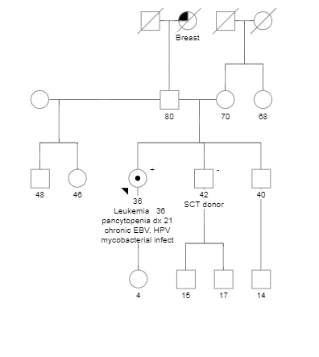

Slide 23
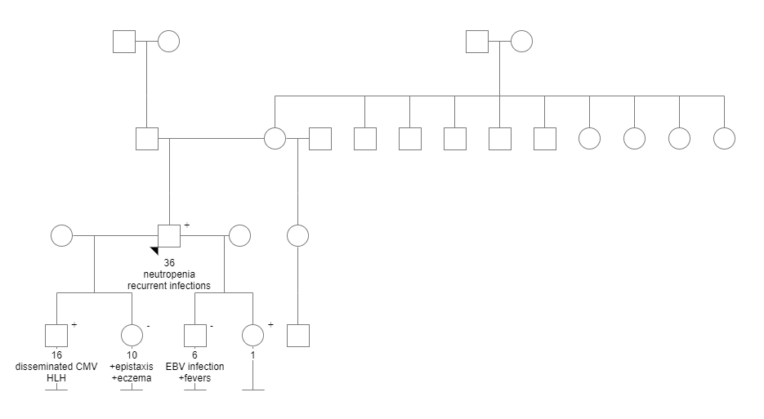

Slide 24
GATA2 deficiency
Gene: GATA2 Autosomal dominant
Two syndromic presentations (can overlap):
Primary lymphedema, sensorineural deafness, cutaneous warts, low T-cell ratio, MDS/AL
MonoMac syndrome– dendritic cell, monocyte, NK cell deficiencies with atypical mycobacterial infections, pulmonary alveolar proteinosis, MDS/AL predisposition
Lifetime risk of 70% for MDS/AML, mean age: 29 years
4/12 (33%) and 4/27 (15%) of familial MDS/AML cases in small series
Up to 75% of monosomy 7 AML cases in adolescents
Spinner et al. Blood 2014; Dickinson et al. Blood 2014; West et al. Haematologica 2014.

Slide 25
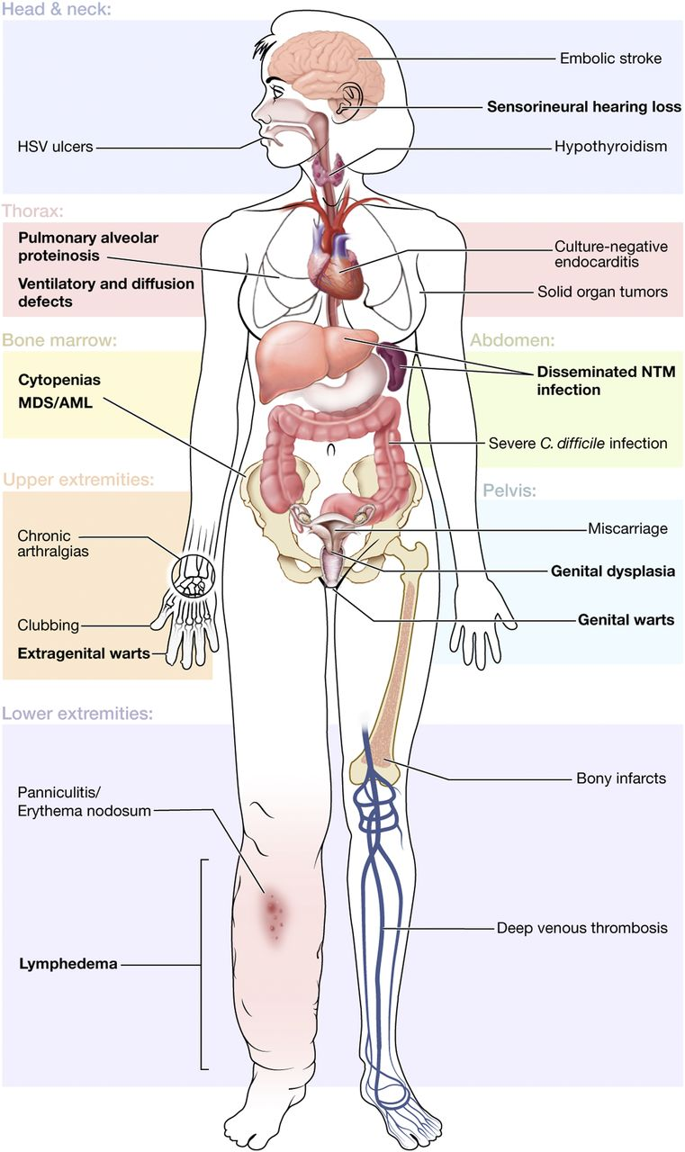
Features of GATA2 Syndrome
Spinner et al, Blood 2014

Slide 26
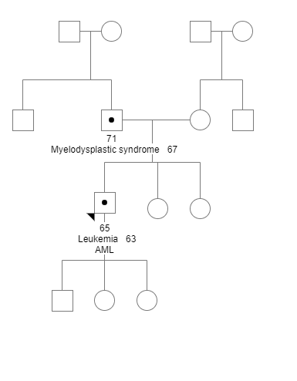

Slide 27
DDX41-related familial AML
DDX41 (DEAD/H-box helicase) involved in pre-mRNA splicing
Lifetime risk of high-grade myeloid neoplasms estimated between 20-30%, estimated to account for ~1-2% all MDS/AML patients
Average age of diagnosis: 61 years, overlaps with de novo AML
Several recurrent germline mutations have been described, notably p.D140fs, often seen with a recurrent somatic “hit”, p.R525H on the second allele
Myeloid malignancies in DDX41+ carriers show increased response rate to lenalidomide with or without del(5q)
At least two reported cases of donor-derived leukemia following MRD-SCT in DDX41+ families
GERMLINE
→
SOMATIC →
Polprasert et al. Cancer Cell 2015; Kobayashi et al. Leukemia 2017; Berger et al. Leukemia 2017.

Slide 28
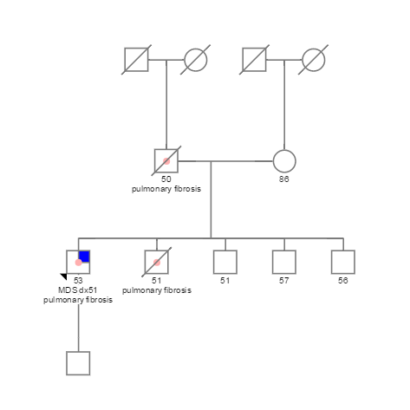

Slide 29
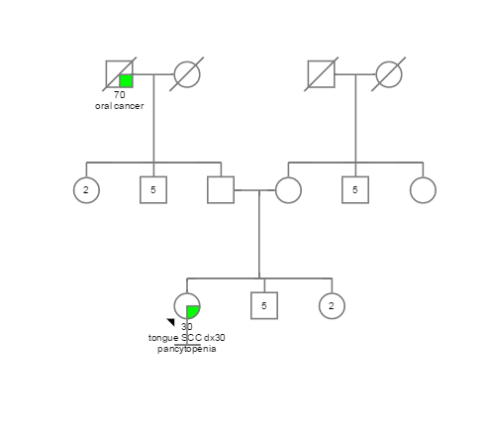

Slide 30
Dyskeratosis congenita (DC)
Telomere biology disorder associated with premature aging phenotype
Classic triad: oral leukoplakia, reticular skin pigmentation, nail dystrophy, historically associated with pediatric-onset bone marrow failure (X-linked due to DKC1)
Recent studies reveal milder phenotype characterized by adult-onset familial MDS/AML with or without pulmonary or liver fibrosis, extending the spectrum of DC from primarily pediatric X-linked and AR condition to autosomal dominant cancer-predisposition syndrome
Risk of bone marrow failure, myeloid neoplasm, and/or squamous cell carcinoma estimated to be 50% by age 40
11 genes associated: TERT, TERC, RTEL1, CTC1, NOP10, NHP2, DKC1, PARN, ACD, WRAP53, TINF2
Autosomal dominant, autosomal recessive, and X-linked inheritance
Telomere length analysis by flow-FISH is best diagnostic test (<1st %ile compared to age-matched controls)
Fogarty et al. Lancet 2003. Calado et al. PLoS ONE 2009; Parry et al. Blood 2011; Holme et al. Br J Haematol 2012. Armanios. Annu Rev Genomics Hum Genet 2009; Alter et al. Blood 2009.

Slide 31
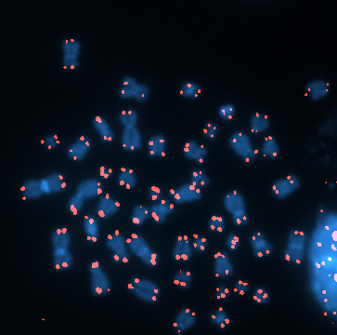
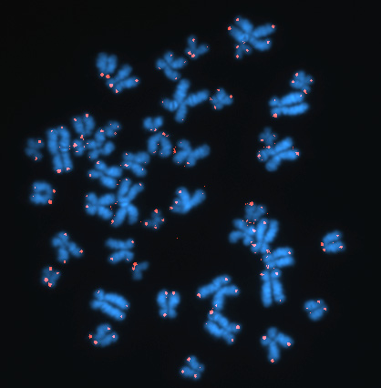
Short Telomeres & Signal-Free Ends
(Dx by Telomere Flow FISH)
Control 18y
DKC 10y
Baerlocher et al, Nat Prot 2006
Notes:
Flow-FISH (fluorescent in-situ hybridization) is a cytogenetic technique to quantify the copy number of specific repetitive elements in genomic DNA of whole cell populations via the combination of flow cytometry with cytogenetic fluorescent in situ hybridization staining protocols.^{[1]} Flow-FISH is most commonly used to quantify the length of telomeres, which are stretches of repetitious DNA (hexameric TTAGGG repeats) at the distal ends of chromosomes^{[2]} in human white blood cells, and a semi-automated method for doing so was recently published in Nature Protocols.^{[1]} Telomere length in white blood cells has been a subject of interest because telomere length in these cell types (and also of other somatic tissues) declines gradually over the human lifespan, resulting in cell senescence, apoptosis,^{[3]} or transformation.^{[4]} This decline has been shown to be a surrogate marker for the concomitant decline in the telomere length of the hematopoietic stem cell pool, with the granulocyte lineage giving the best indication, presumably due to the absence of a long lived memory subtype and comparatively rapid turnover of these cells.^{[5]}
It is not known precisely how the mutations lead to telomere shortening. Presumably, the lower levels of telomerase are not sufficient to maintain telomere length in stem cells & renewable tissues
Large & small deletions, insertions & point mutations; thought to be haploinsufficiency
Telomerase is a reverse transcriptase which maintains a specific repeat sequence of DNA, the telomere, during development. Telomeres are placed by telomerase on both ends of linear chromosomes as a way to protect linear DNA from general forms of chemical damage and to correct for the chromosomal end-shortening that occurs during normal DNA replication.^{[4]} This end-shortening is the result of the eukaryotic DNA polymerases having no mechanism for synthesizing the final nucleotides present on the end of the "lagging strand" of double stranded DNA. DNA polymerase can only synthesize new DNA from an old DNA strand in the 5'->3' direction. Given that DNA has two strands that are complementary, one strand must be 5'->3' while the other is 3'->5'. This inability to synthesize in the 3'->5' directionality is compensated with the use of Okazaki fragments, short pieces of DNA that are synthesized 5'->3' from the 3'->5' as the replication fork moves. As DNA polymerase requires RNA primers for DNA binding in order to commence replication, each Okazaki fragment is thus preceded by an RNA primer on the strand being synthesized. When the end of the chromosome is reached, the final RNA primer is placed upon this nucleotide region, and it is inevitably removed. Unfortunately once the primer is removed, DNA polymerase is unable to synthesize the remaining bases.^{[4][5]}

Slide 32
Fanconi anemia
Classically characterized by limb anomalies, dysmorphic features, short stature, early-onset bone marrow failure (childhood)
Recent studies indicate up to 40% of pts with FA lack physical findings & are also less likely to develop pediatric bone marrow failure
Patients who do not present in childhood often develop BMF, MDS/AML, solid tumors, and increased toxicity from chemotherapy and radiation in adulthood
Lifetime risk of BMF is 75-90% with 50% risk of progression to MDS, AML
16 genes (complementation groups) cause FA in either autosomal recessive or X-linked inheritance (BRCA2, BRIP1, PALB2, RAD51, FANCA, FANCC, etc)
Gold standard diagnostic test is chromosome breakage studies with diepoxybutane (DEB) or mitomycin C
Small percentage of false positive due to somatic reversion in peripheral blood
Kee et al. J Clin Invest 2012; Rosenberg et al. Blood 2003; Soulier et al. Blood 2005; Nickels et al. Ther Adv Hematol 2013.

Slide 33
Treatment Considerations in Patients with iBMFS
Allogeneic HSCT remains the only curative option for bone marrow failure in patients with iBMFS
In all cases, HSCT with a mutation + related donor confers very high risk of graft failure
Early studies of myeloablative conditioning in patients with DC resulted in very poor short-term and long-term survival (<30% surviving at 10 years)
High rates of hepatic and pulmonary fibrosis, late onset veno-occlusive disease of the liver
Reduced intensity conditioning (RIC) recommended universally for patients with DC
Individuals with Fanconi Anemia are at risk for significant toxicity from standard conditioning regimens
Dietz et al. Bio Blood Marrow Transplant 2017., Shimamura, Alter. Blood Rev 2010.

Slide 34
Eight years later…(2017)
Slide courtesy of Kayla Hamilton, MS, CGC, St. Jude Children’s Hospital

Slide 35
Familial AML with mutated CEBPA
Gene: CEBPA
Autosomal dominant
Nearly 100% penetrant for AML (dx 2-59)
No other hematologic manifestations
Harbor biallelic CEBPA mutations in the AML
Typically 5’ mutation (germline) and a second somatic CEBPA mutation acquired at the time of progression to AML
Often concomitant somatic GATA2 mutation(s)
Prevalence: unknown (~1% of all AML cases)
Genetic testing recommended in all patients with biallelic somatic CEBPA mutations
In two series: 5/71(7%) and 2/18 (11%) cases with at least one CEBPA somatic mutation had a germline CEBPA mutation

Slide 36
Familial ALL syndromes
Familial ALL is very rare
PAX5 mutations reported in 3 cases of familial ALL
PAX5 plays central role in B-cell development and differentiation; aberrant up-regulation has been associated with pre-B ALL in children
In all 3 families reported (different ethnicities), the same missense mutation reported c.547G<A (p.Gly183Ser) with deletion of the wild-type chromosome 9p in all patients who developed ALL
Li-Fraumeni syndrome
Strongly associated with low-hypodiploid ALL
SH2B3-associated familial ALL
Autosomal recessive
Penetrance unknown
Constitutional Mismatch Repair Deficiency (CMMRD)
NF1 phenotype overlap (café-au-lait macules)
Biallelic (recessive) MLH1, MSH2, MSH6, PMS2 mutations

Slide 37
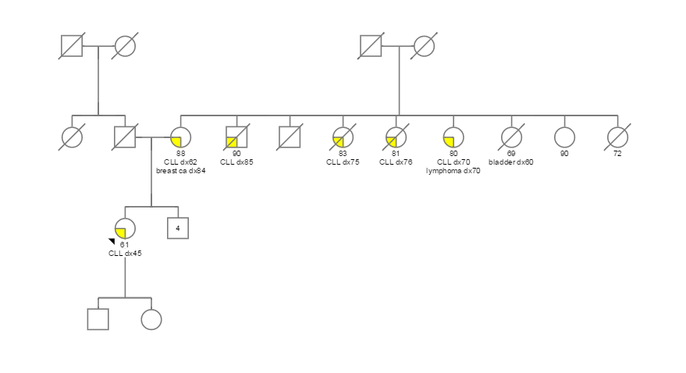

Slide 38
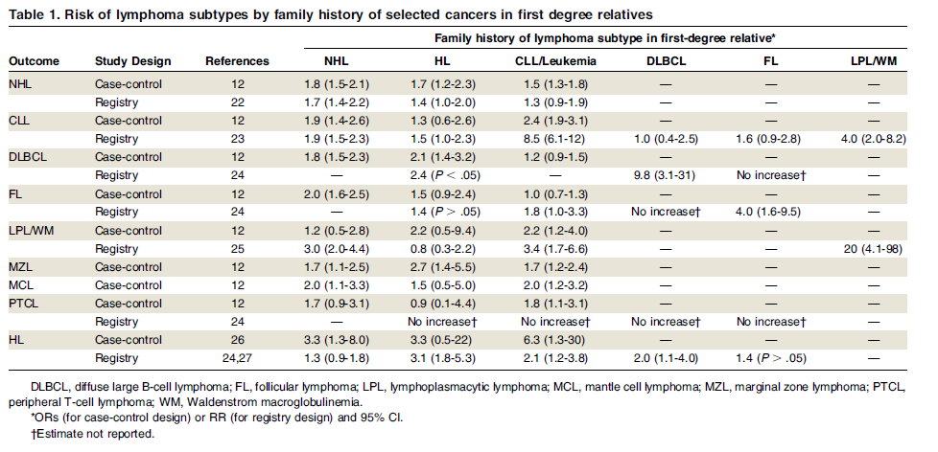
Familial B-cell LPDs
Cerhan and Slager. Blood 2015;126(20).

Slide 39
Genetic Testing Options & Considerations

Slide 40
Genetic Testing Approach
Genetic testing for the majority of susceptibility genes is clinically available in the US
…but frustratingly insufficient for the current needs of leukemia patients
Panel-testing approach is ideal for multiple reasons– but must be critically assessed
Overlapping clinical phenotype (RUNX1, ANKRD26, ETV6)
Limitations of current genetic testing options
Some labs offer “leukemia” panels that are incomplete, have inappropriate genes, or do not accept skin fibroblasts
Some labs offer custom panels for all identified genes via a customizable exome or phenotype-driven WES test

Slide 41
Tissue Selection
In leukemia, peripheral blood = tumor tissue
Blood & bone marrow in patients with leukemia are altered both by somatic mutations and cytogenetic aberrations, complicating analysis of peripheral blood (false positives & negatives)
DNA extracted from cultured skin fibroblasts is the only unequivocal source of germline DNA currently accepted for germline testing at major CLIA-certified labs
Saliva and buccal swabs contain a significant number of peripheral blood-derived cells, leading to tumor contamination in leukemia patients
Saliva and blood can be used for testing in patients with multiple myeloma or lymphoma* if it has never involved the bone marrow
*patients s/p autologous stem cell transplant are at higher risk for clonal hematopoiesis

Slide 42
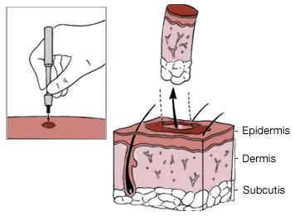
Skin punch biopsy
Relatively quick procedure
Sterile field created with biopsy kit, can be performed in outpatient clinic or at the time of bone marrow biopsy/aspiration
Normal skin
Skin fibroblasts must be cultured in CLIA-environment before testing
Procedure is overwhelmingly acceptable to patients
Limits genetic testing lab options

Slide 43
Tissue Selection Checklist
Patients with active leukemia or lymphoma involving the bone marrow (stage IVB): skin fibroblasts
Patients s/p matched related- or unrelated-donor SCT (allogeneic): skin fibroblasts (Peripheral blood contains lymphocytes from donor stem cells = donor DNA)
Patients s/p autologous SCT in remission: peripheral blood*
Acute leukemia in remission: The specific malignancy and the depth of remission guide the specimen for testing Durable CR is preferable = morphologic remission on BMA and negative MRD/flow cytometry for at least 1, preferably >2-3 years Skin fibroblasts
Patients with chronic leukemia (CLL/CML): Chronic leukemia does not achieve complete remission even in remission phase Skin fibroblasts
*post-transplant patients have a high incidence of CHIP and other bone marrow sequelae after conditioning regimens– some experts would still recommend skin fibroblasts as most accurate

Slide 44
Surveillance Recommendations

Slide 45
Current Expert Opinion/Consensus Statements
For unaffected patients with inherited susceptibility syndrome:
Clinical exam with complete blood count with differential (CBC) every 6 months
Baseline bone marrow biopsy and aspiration at diagnosis, consider annually, and with any new or emerging cytopenias
Include cytogenetic, flow cytometry, and molecular characterization of the bone marrow at diagnosis and on subsequent analysis for clonal surveillance
Consider allogeneic hematopoietic stem cell transplant at the development of dysplasia, or clonal cytogenetic or molecular abnormality
Genetic counseling for at-risk family members (especially potential SCT donors)
There is no evidence to recommend screening in unaffected individuals if appropriate genetic testing in the affected relative(s) has been negative for mutations
Churpek JE et al. Leuk & Lymph 2012; Akpan et al. Curr Hematol Malig Rep 2018. Kanagal-Shamanna et al. Haematologica 2017.

Slide 46
Ethical Considerations & Conclusions

Slide 47
Compared to patients with solid tumors
In families with leukemia, genetic testing has many (but not all) of the same benefits, risks, and limitations as that of other hereditary cancer syndromes
Slightly increased risk of genetic testing procedure (bleeding or infection from skin biopsy)
Treatment and cure of leukemia often depends on family members
The preferential donor for HSCT is an HLA-matched (10/10) related donor

Slide 48
Ethical Considerations
The case for identifying families with inherited predispositions to hematologic malignancy is clear, especially in the setting of HSCT planning
However, there are currently no risk-reducing or preventative actions to take to reduce the risk of developing leukemia/MDS/BMF in unaffected mutation carriers
In the absence of measures proven to reduce the development of leukemia and/or reduce morbidity and mortality:
Patients must be made aware that genetic testing is optional and the associated risks & benefits and provide informed consent
Unaffected family members must be aware that genetic testing is optional and that the results not only affect SCT-donor eligibility, but also determine his/her own lifetime risks for leukemia
Main benefits
Early detection and treatment, transplant conditioning regimen selection, HLA-matched donor selection in advance, potential for future treatments/chemoprevention, reduced uncertainty

Slide 49
Conclusions & Unresolved Questions
Inherited predispositions to hematologic malignancy are more prevalent than we have historically appreciated
Diagnosis requires attention to patient and family history, additional work-up and evaluation
Leukemia is associated with high morbidity and rapid mortality
And…
Can secondary/somatic mutations identify germline patients at risk of malignant progression?
What is the appropriate monitoring/surveillance program prior to and after identification?
What are our effective early intervention strategies?

Slide 50
Questions? sabannon@mdanderson.org

